Slide 1
Medical Necessity Reviews and Denials
Danica Crittenden
Shernoff Bidart Echeverria LLP

Slide 2
Subscriber/
Insured
Treating Physician or Facility
HMO/Insurer
Prospective review or precertification
Retrospective review
Concurrent review
Clinical Reviewer
Medical Director

Slide 3
Sarchett v. Blue Shield of California (1987) 43 Cal.3d 1,12-13
“When [preadmission] screening is not feasible, … we think the best the courts can do is give the policy every reasonable interpretation in favor of coverage. We trust that, with doubts respecting coverage resolved in favor of the subscriber, there will be few cases in which the physician's judgment is so plainly unreasonable, or contrary to good medical practice, that coverage will be refused.”
Hughes v. Blue Cross of Northern California (1989) 215 Cal.App.3d 832, 845

Slide 4
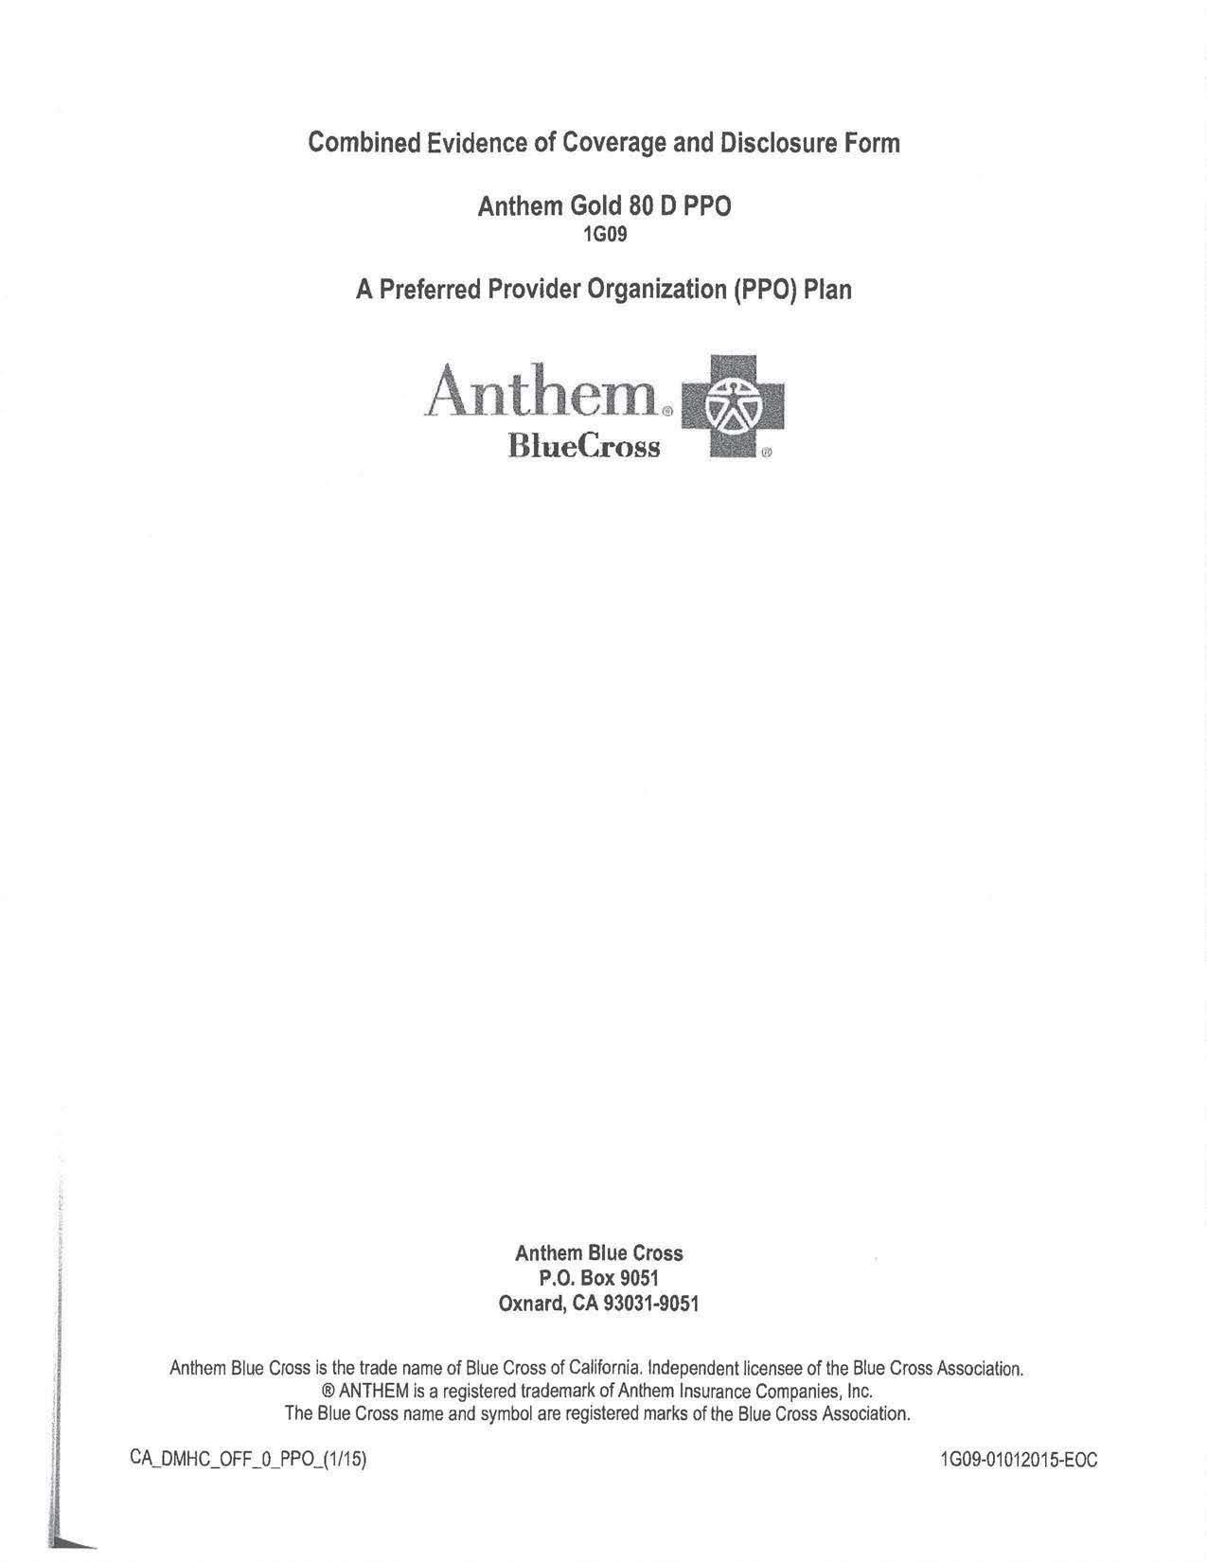

Slide 5
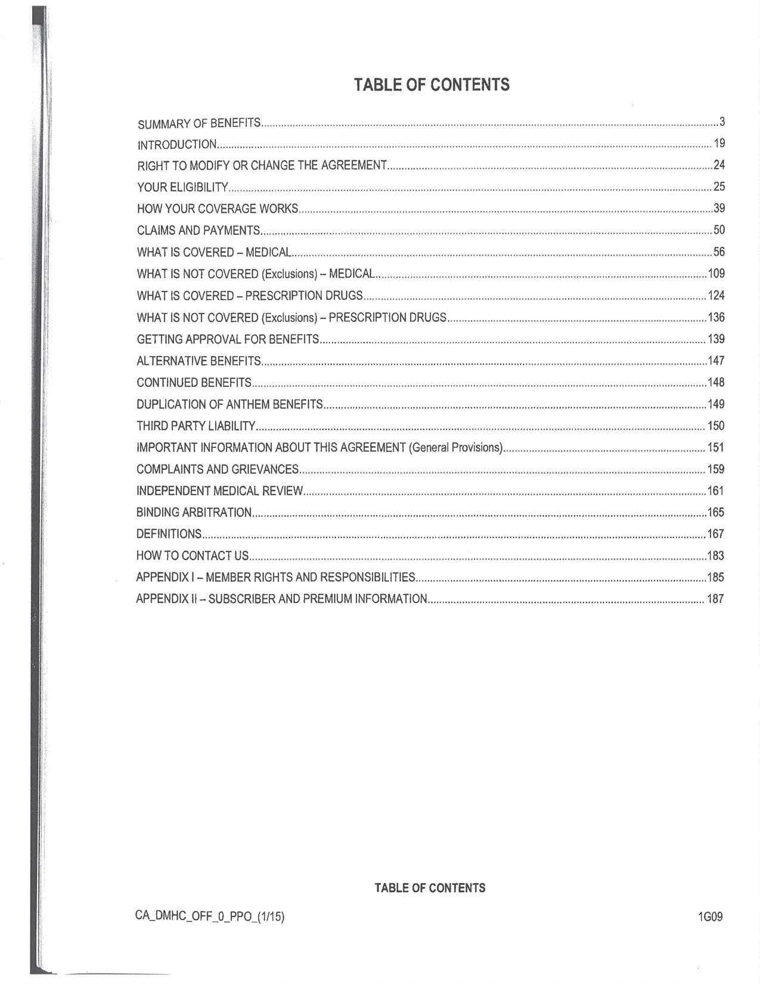

Slide 8
This means credible scientific evidence published in peer-reviewed medical literature generally recognized in the medical community

Slide 10
Rules of Construction
“[P]olicy exclusions are strictly construed while exceptions to exclusions are broadly construed in favor of the insured.” (E.M.M.I. Inc. v. Zurich American Ins. Co. (2004) 32 Cal.4th 465, 471.)
“To be enforceable, any provision that takes away or limits coverage reasonably expected by an insured must be ‘conspicuous, plain and clear.’” (Haynes v. Farmers Ins. Exch. (2004) 32 Cal.4th 1198, 1204.)

Slide 11
Health & Safety Code §1363(a-d)
An EOC must provide in concise and specific terms “[t]he exceptions, reductions, and limitations that apply to the plan” in order to be enforceable. (§1363(a))
Exception - a specified hazard or condition is entirely eliminated (Subsection b)
Reduction - reduces the amount of a plan benefit to some amount or period less than would be otherwise payable (Subsection c)
Limitation - any other provision which restricts coverage (Subsection d)

Slide 12
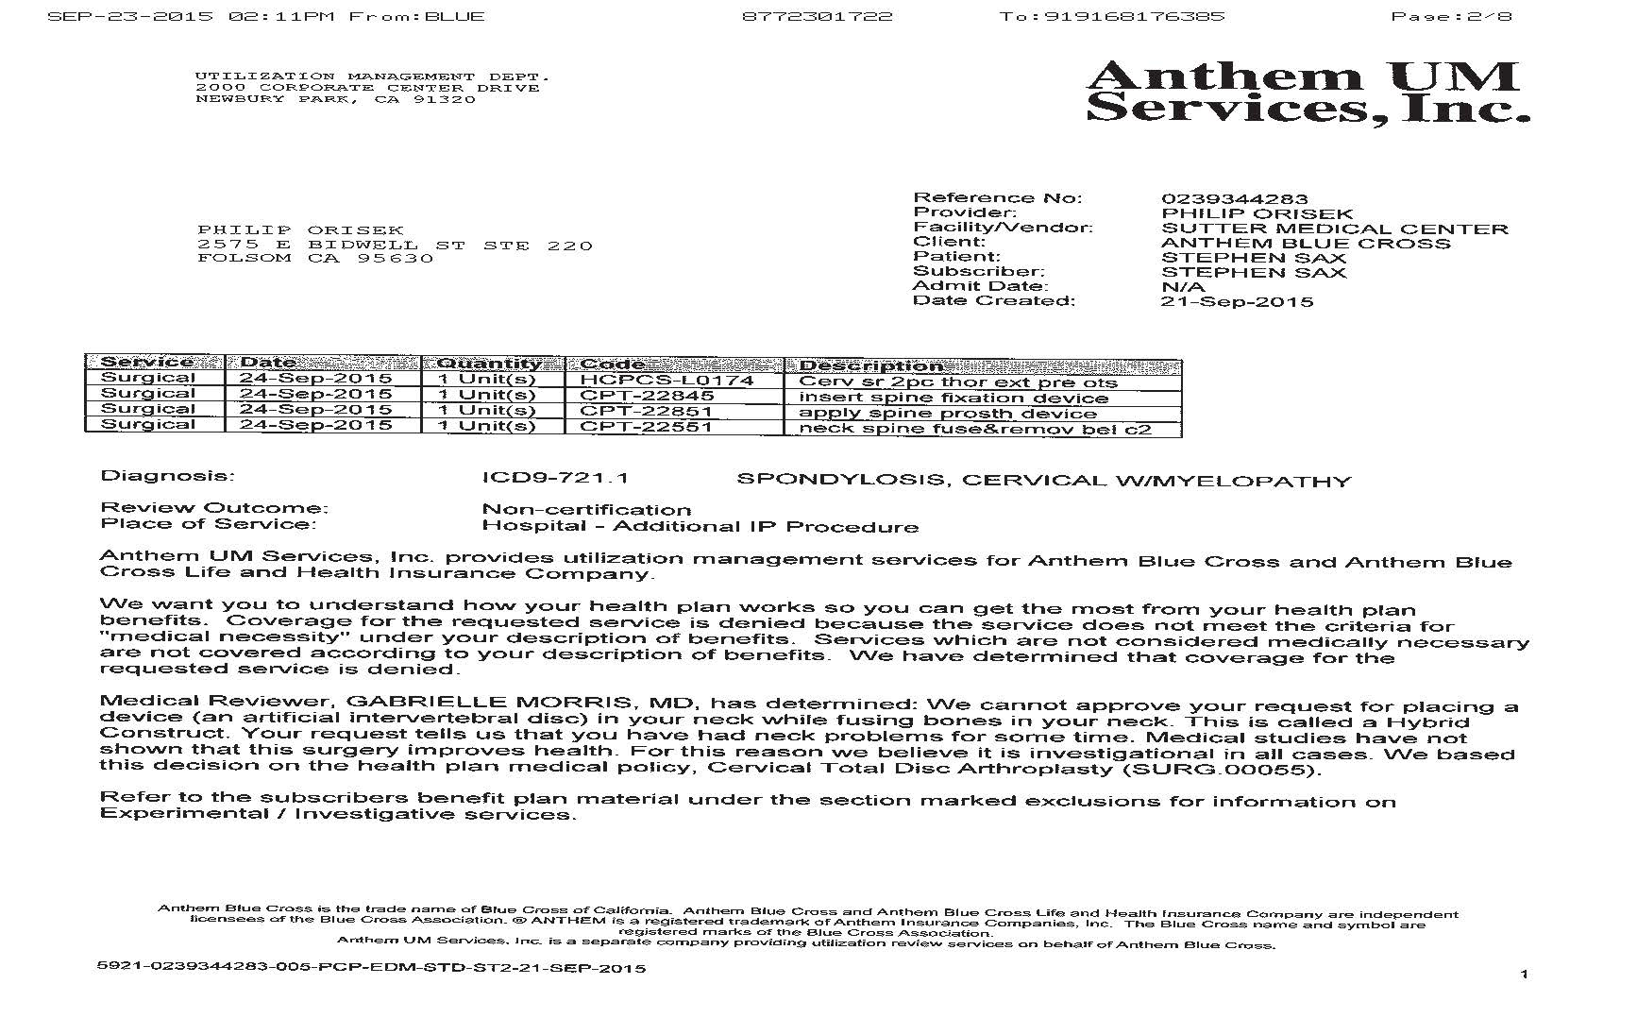
Sample Blue Cross Denial Letter

Slide 13
Sample Blue Cross Denial Letter

Slide 14
External Medical Guidelines and Policies

Slide 15
EOC - External Guidelines

Slide 16
Current Guideline – SURG.00055

Slide 17
Current Guideline – SURG.00055

Slide 18
Current Guideline – SURG.00055
1
2
3
4
This exclusion was added to SURG.00055 on August 8, 2013 (see next slide)
5
All of these are predetermined exclusions

Slide 19
Document History – SURG.00055

Slide 20
Danica Crittenden
Shernoff Bidart Echeverria LLP
dcrittenden@shernoff.com

